Slide 1


Slide 2
Apache Kafka
Apache Kafka is a distributed streaming platform:
Send to and receive messages from recording streams
Recording streams error-proof
Real time processing on recording streams
Notes:
Publish and subscribe to streams of records, similar to a message queue or enterprise messaging system.
Store streams of records in a fault-tolerant durable way.
Process streams of records as they occur.

Slide 3
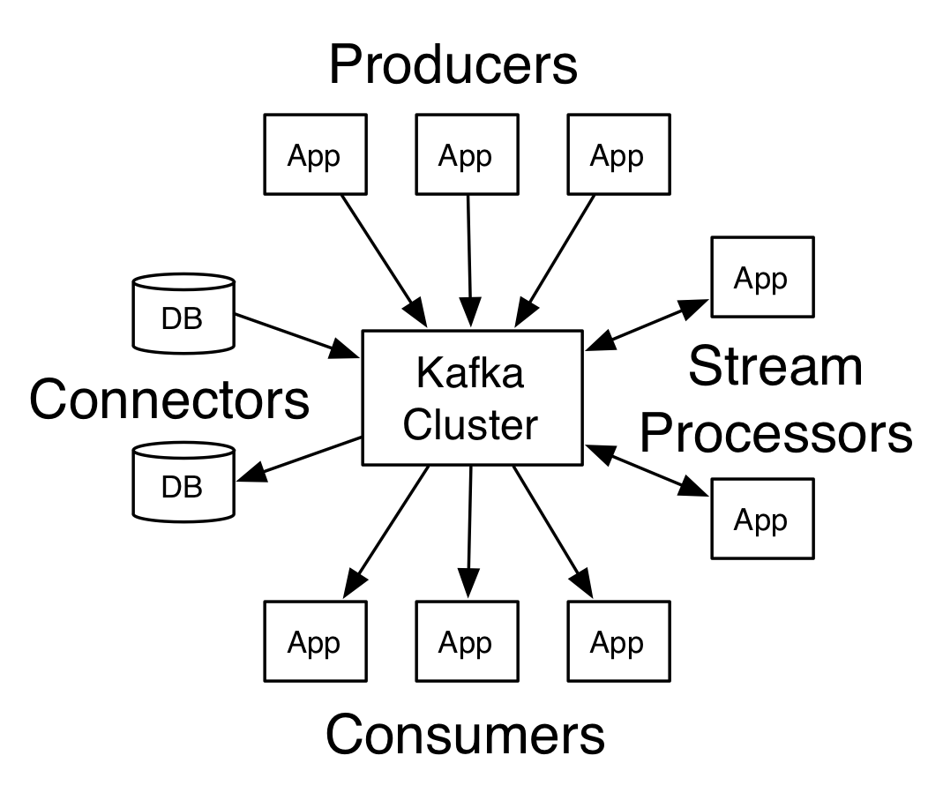
Apache kafka API
Producer API
Consumer API
Streams API
Connector API
Notes:
The Producer API allows an application to publish a stream of records to one or more Kafka topics.
The Consumer API allows an application to subscribe to one or more topics and process the stream of records produced to them.
The Streams API allows an application to act as a stream processor, consuming an input stream from one or more topics and producing an output stream to one or more output topics, effectively transforming the input streams to output streams.
The Connector API allows building and running reusable producers or consumers that connect Kafka topics to existing applications or data systems. For example, a connector to a relational database might capture every change to a table.

Slide 4
Use
Apache Kafka can be applied to a wide variety of use cases and industries.
Logistics companies can make applications to track their shipments quickly, reliably and in real time
The financial industry can build applications to aggregate data sources for real-time views of potential risks and to detect and minimize fraudulent transactions.
Travel companies can implement applications with the Kafka Streams API to make real-time decisions to find the best price for individual customers, cross-sell additional services, and process reservations and reservations.
Automotive and manufacturing companies can implement applications to monitor telemetry data from connected vehicles to ensure optimum performance of their production lines, gain real-time insight into their supply chains and decide whether an audit is required.

Slide 5







Who uses Apache Kafka?

Slide 6
Motivation
The key motivation of the Kafka Streams API is to bring stream processing from the Big Data niche to the mainstream application development world and radically improve the developer and operations experience by making stream processing simple and easy.
Using the Kafka Streams API, you can implement standard Java applications to solve your small or large-scale stream processing needs and then run those applications on client machines around your Kafka cluster.
Your applications are completely elastic: you can run one or more instances of your application; they will automatically discover each other and process data collaboratively.
Your applications are also fault-tolerant: if one of the instances dies, the remaining instances automatically get their run - with no data loss.
You are free to choose any technology that can use Java applications including but not limited to Deployment-wise, Puppet, Chef, Ansible, Docker, Mesos, YARN, Kubernetes and others.

Slide 7
“Build applications, not infrastructure!”
The approach of the Kafka Streams API is in stark contrast to other stream processing tools that require you to set up and run similar heavy infrastructure with separate processing sets and their own custom rules on how to use and interact with them.

Slide 8
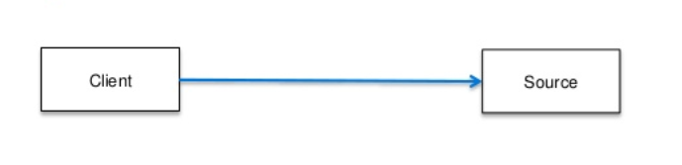
Why Kafka?
Data pipelines start this way

Slide 9
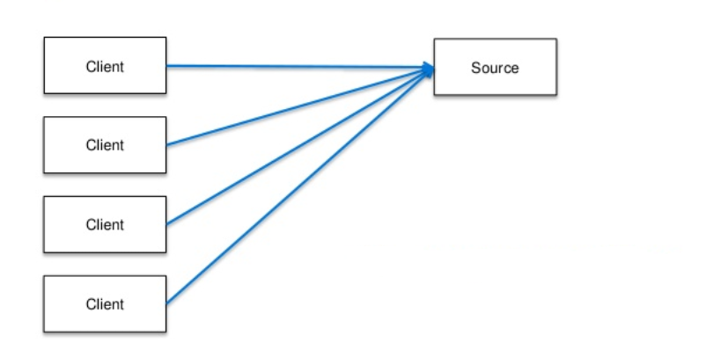
Why Kafka?
Then we use them again

Slide 10
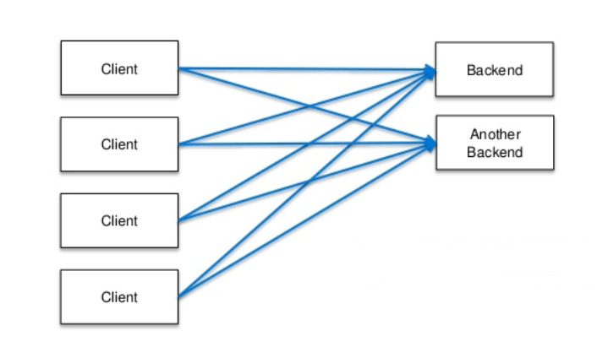
Why Kafka?
Then we add additional endpoints to existing resources

Slide 11
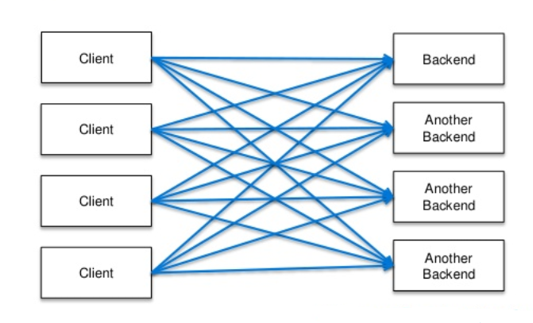
Why Kafka?
Then it starts looking like this

Slide 12
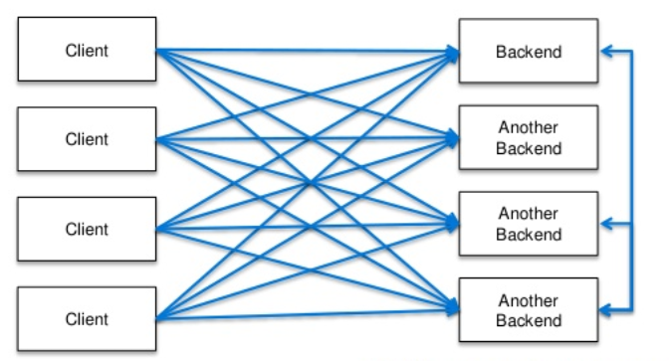
Why Kafka?
Or this way
This is a fragile system as distributed systems and services are increasingly part of modern architecture

Slide 13
Why Kafka?
Powerful
Makes your applications highly scalable, elastic, distributed, fault tolerant
Supports the meaning of exactly one action (exactly-once).
State full and stateless operations are supported.
Chooses between a declarative, functional API and a lower level mandatory API for maximum control and flexibility

Slide 14
Why Kafka?
Lightweight:
Equally applicable for small, medium, large and very large use cases
The smooth path from local development to large-scale
No external dependencies other than production Apache Kafka

Slide 15
Why Kafka?
Fully integrated
Easy integration into existing applications and micro services
Works anywhere: in-house, public clouds, private clouds, containers, etc.
Integrates with databases with continuous change data capture (CDC-Change Data Capture) performed by Kafka Connect.

Slide 16
Why Kafka?
Real Time
Millisecond processing latency
Record process every time (no micro processing)
It processes late-arriving and out-of-order data smoothly.
Safe
Supports transit data encryption (encryption of data-in-transit)
Authentication and authorization support

Slide 17
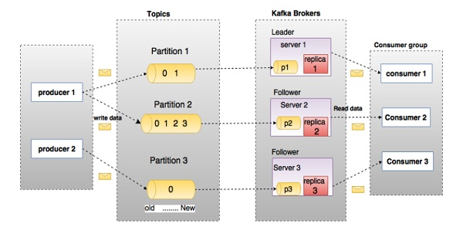
Terminologies
Producers
Consumers
Leader
Follower
Topics
Partition
Partition offset
Replicas of partition
Brokers
Kafka Cluster
Streams

Slide 18
Producers ve Consumers
They publish a message to one or more Kafka topics.
Producers send messages to Kafka brokers.
Every time the producer publishes a message to the broker, the broker appends the message to the end of the segment file.
Producer can also send the message to any partition.
Consumers read messages from brokers.
Consumers can subscribe one or more topically.

Slide 19
Topics
A message flow belonging to a particular category is called topics. It is stored in data topics.
Topics are divided into partitions.
Kafka keeps at least one partition for each topic.
Each partition keeps messages in a literally ordered sequence.
Each partition message has a unique sequence id called "offset".

Slide 20
Brokers
It is a simple system responsible for the protection of published data.
Each broker can contain 0 or more partitions for each topic.
A broker can read and write hundreds of thousands per second.
We come across 3 scenarios.
N partition - N broker
N partition - N+M broker
N partition – N-M broker

Slide 21
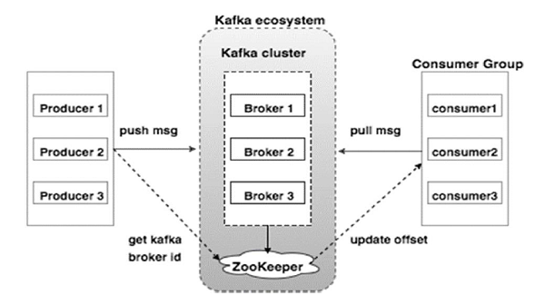
Kafka Cluster
Kafka Cluster is that Kafka has more than one broker. The Kafka cluster can be extended without downtime.
Kafka clusters prefer multi-broker structure to ensure load balance.
Kafka brokers use Zookeeper because they have a stateless structure.

Slide 22
Zookeeper
Zookeeper is used to manage and coordinate the Kafka broker.
It is mainly used to inform the producer and consumer about the existence of a new broker in the Kafka system or the failure of the Broker in the Kafka system.
According to the notification received by Zookeeper about the existence or failure of the broker, the producer and the consumer make a decision and continue their duties with another broker.

Slide 23
The topic in the diagram is structured with 3 partitions.
Partition 1 has 2 offsets. These are 0 and 1.
Replicas' id is the same as the server hosting it.
Suppose the replication factors in the topic are set to 3. In this case, Kafka will create 3 replicas for each partition and distribute them evenly across the cluster.
To balance the load on the cluster, each broker can store 1 or multiple.
Multiple producer can send messages and more than one consumer can read messages.

Slide 24
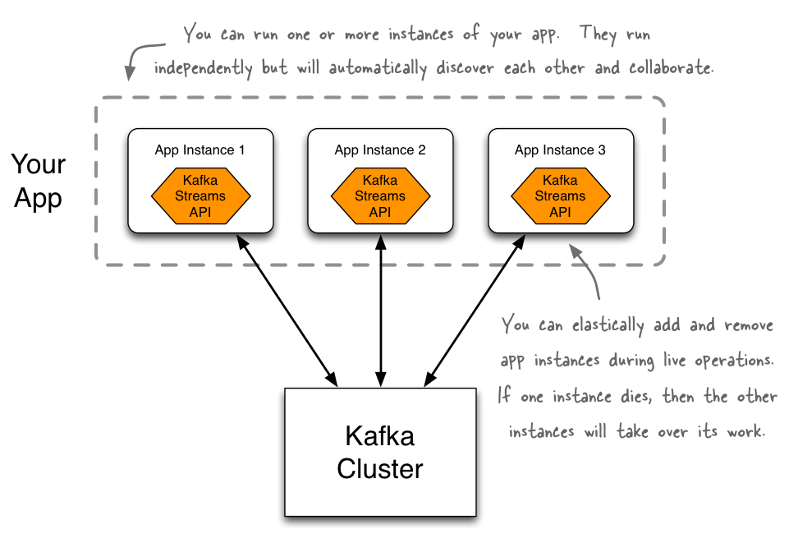
Kafka Streams
Built on Kafka Streams, Kafka producer and consumer APIs,
data parallelsim,
distributed coordination,
fault tolerance
operational simplicity
It aims to develop applications within the framework of its objectives.

Slide 25
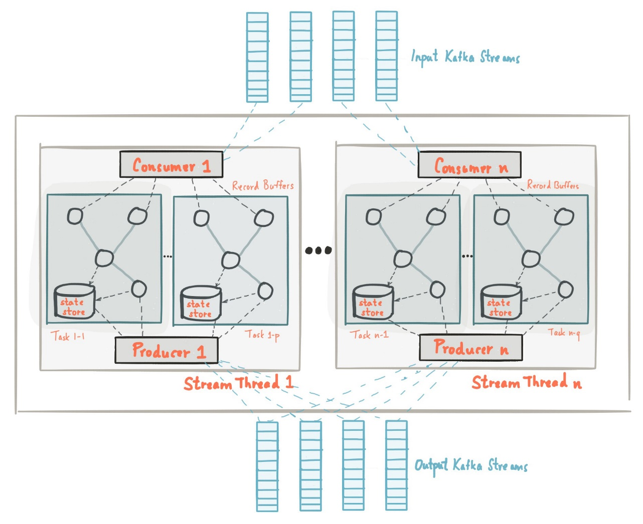
Streams Architecture
Processor Topology
Parallelism Model
Threading Model
State
Memory management
Fault Tolerance

Slide 26
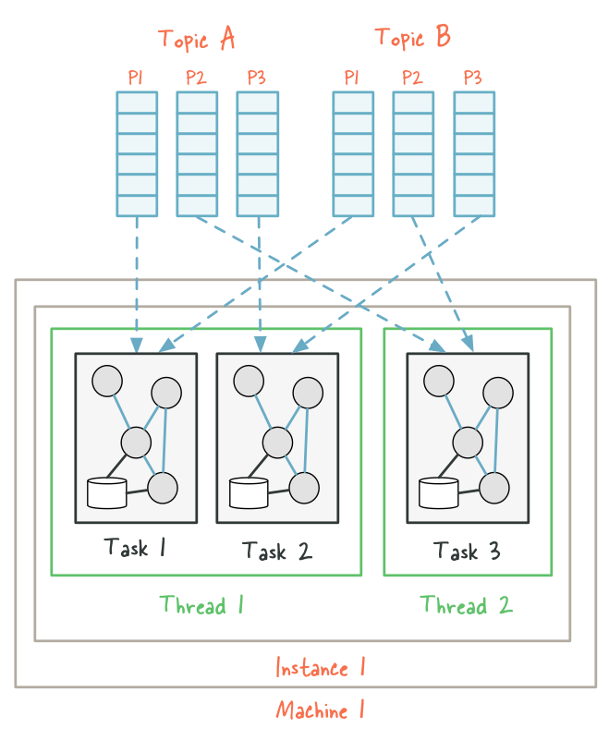
Let's consider a Kafka Stream structured as 2 topics named A and B, each consisting of 3 partitions.
If we consider that we are running our application with 2 threads on one machine. We access 2 stream threads, they are instance1-thread1 and instance2-thread2.
Kafka Streams divides this topology into 3 tasks by default because the maximum number of partitions is 3 and 6 input topic partitions are distributed equally to these 3 tasks. In this case, each task processes one partition of each topic. And there are 2 input partitions for each task.
Finally, these 3 tasks will be distributed as evenly as possible.
In this example, the first thread will run 2 tasks using 4 partitions, while thread 2 will run 1 task using 2 partitions.

Slide 27
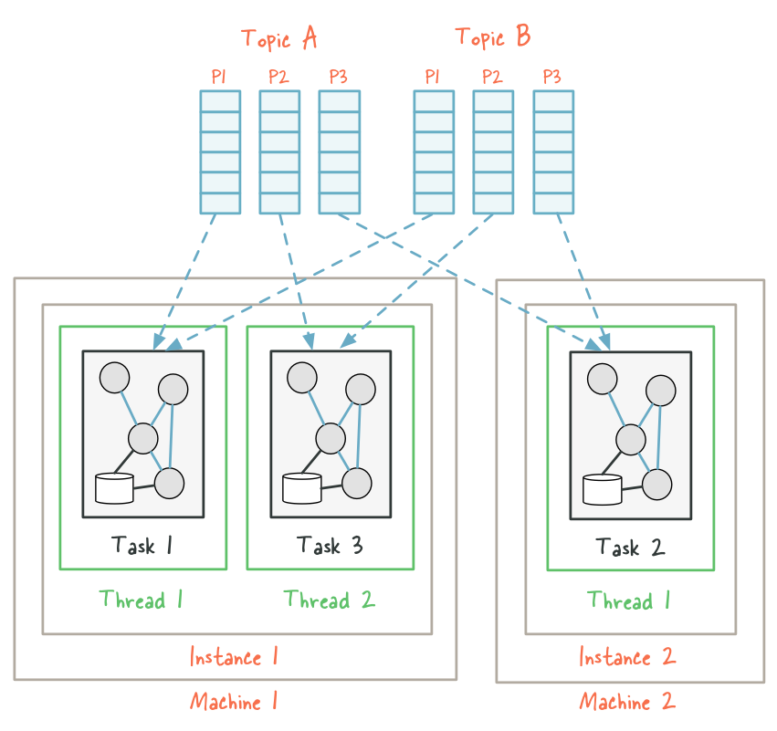
Now suppose we want to develop this example. Let's assume that the data size has increased significantly.
Let's run the same application on 2 machines. We have 2 threads on the first machine and we have 1 thread on the second machine. On the 2nd machine, instance2-thread1 will be created and the input partitions will be distributed immediately as shown.
When re-assignment occurs, some partitions processed in previous threads will be «migrated» to the new machine.
As a result, Kafka streams will be distributed evenly among application instances according to the workload of Kafka topic partitions.

Slide 28
Prepared by
Dileep Yadav [ SAKOSFT LIMITED ]

